Slide 1
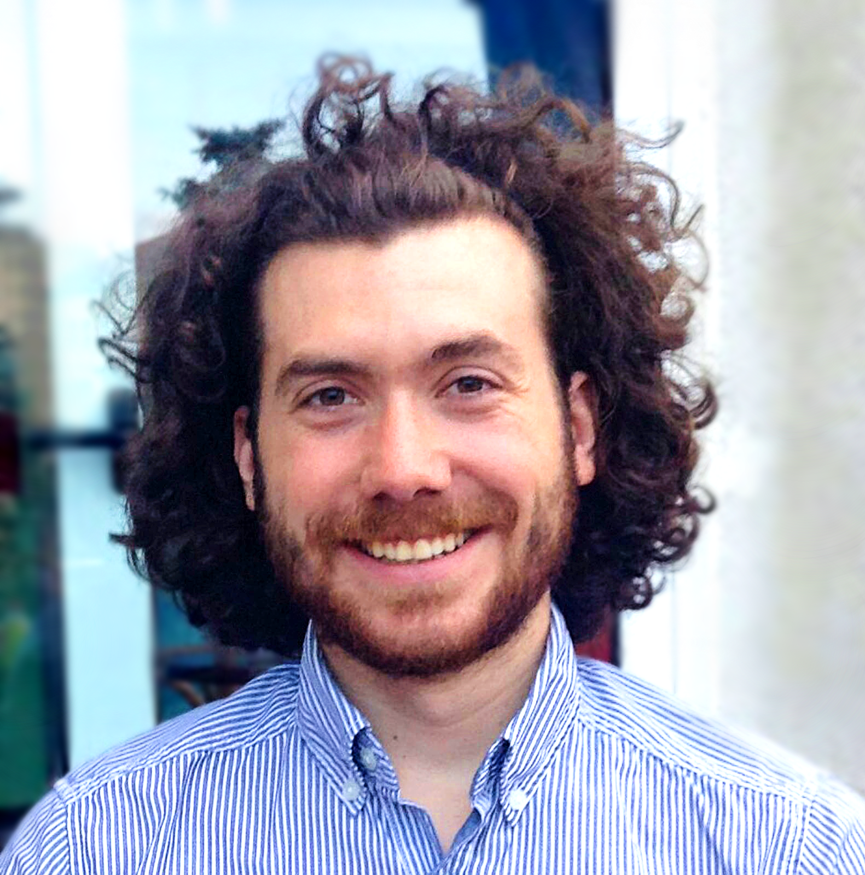
Dénes Csala
Senior Consultant, Data Storytelling
Summary
Project Highlights
Industry Specialization
10 years in data visualisation consulting 8 years in higher education.
Organisational Network Analysis in Finance | Analysed the internal communications records of a medium-sized financial enterprise and engaged with stakeholders of the highest decision-making level to identify influencers and change agents across the community. This has resulted in the company introducing a data-driven performance-metric and overhauled their departmental structure based on the collaboration clusters identified through network science methods.
Data Storytelling in Education | Collated extensive data about all educational institutions within a country and identified the most critical geographic and functional areas to guide governmental investment decisions. Engaged with high-level decision-makers and officials across the relevant government bodies and constructed a data story to help with further approval. As a result, the process of understanding a large and complex dataset was reduced from days to minutes.
Energy Transitions | Analysed historical trade matrices for all countries and created climate-compliant viable energy transitions pathways. The findings have been referenced in international policy documents and have likely been integrated into national sustainable energy transition scenarios of certain countries. The resulting simulation model was the most downloaded in the Energy category on one of the largest online model repositories for several years.
Data Visualisation for Science Communication in Times of Crisis | Created and maintained the largest COVID-19 information site for Romania in order to fight the prevalence of fake news. As part of a team, regularly published analyses and predictions about the potential course of the pandemic. Some of these have been directly incorporated into governance decisions, such as deciding on online or in-person education. The infographics published daily on the site are frequently cited by the largest publications and regularly appear on national television.
Data Science
Energy
Higher Education
Simulation Modelling
Engineering
Dénes is a data scientist experienced in data visualisation and has worked with clients across multiple industries, with stakeholders of the highest decision-making levels. He has also delivered lectures to university-level audiences, appeared in national and international media on energy policy and has published several research papers in scientific outlets of the highest international recognition.
Functional Expertise
Data Visualisation
Machine Learning | Time series
System Dynamics
Energy Economics
Network ScienceScience Communication
Public Speaking / Lecturing
Custom dataviz (python, D3.js)
Dataviz dashboards (mostly PowerBI, but also Tableau, Qlik, microstrategy)
+44 739 8483 468
denes.csala@infosys.com
Lancaster, UK
Education
MSc in Engineering Systems and Management and PhD in Interdisciplinary Engineering, both from Masdar Institute, UAE – in collaboration with MIT, USA
website
portfolio

